Slide 1

Cloud Programming and Software Environments

Slide 2
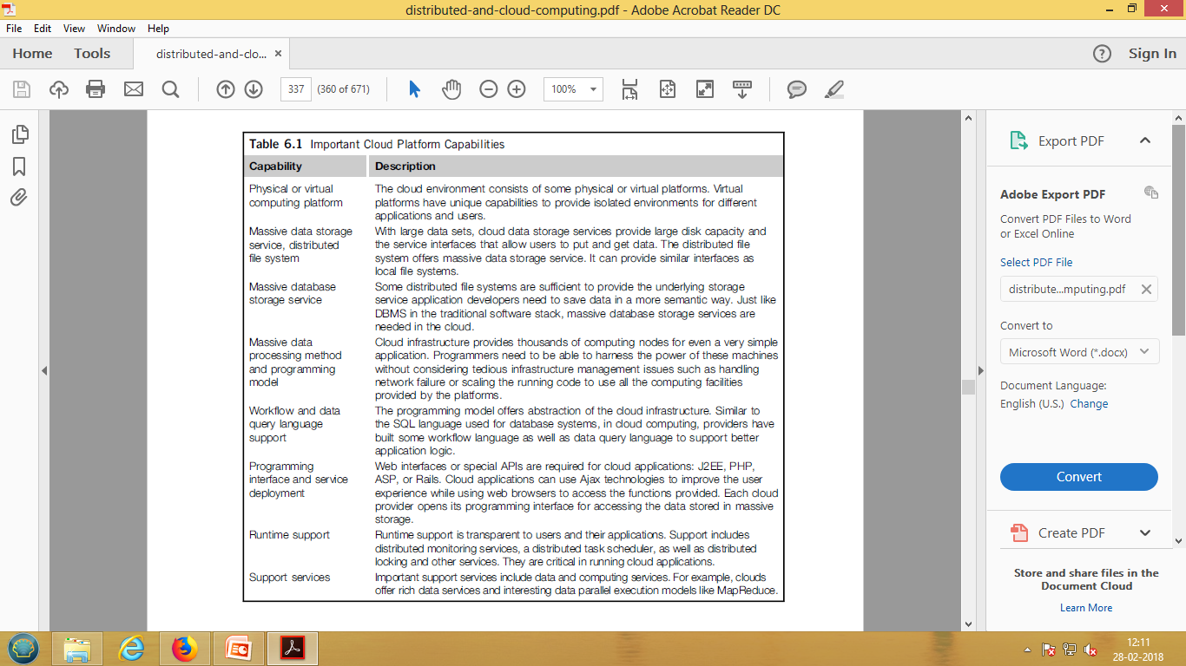
Cloud Platform Capabilities

Slide 3
Parallel and Distributed Programming Paradigms
distributed computing system
a set of networked nodes or workers
system issues for running a typical parallel program
either a parallel or a distributed manner

Slide 4
Partitioning
Computation partitioning
This splits a given job or a program into smaller tasks
Partitioning greatly depends on correctly identifying portions of the job or
program that can be performed concurrently
upon identifying parallelism in the structure of the program,
divide into parts to be run on different workers
Different parts may process different data or a copy of the same data

Slide 5
Data partitioning
This splits the input or intermediate data into smaller pieces
Upon identification of parallelism in the input data it can also be divided
into pieces to be processed on different workers
Data pieces may be processed by different parts of a program or a copy
of the same program

Slide 6
Mapping
This assigns the either smaller parts of a program or the smaller pieces of
data to underlying resources.
This process aims to appropriately assign such parts or pieces to be run
simultaneously on different workers
is usually handled by resource allocators in the system.

Slide 7
Synchronization
different workers may perform different tasks
coordination among workers
race conditions are prevented
Data dependency among different workers is properly managed
Multiple accesses to a shared resource by different workers may raise race conditions
data dependency when a worker needs the processed data of other workers

Slide 8
Communication
data dependency -intermediate data is sent to workers
Scheduling
tasks or data pieces is more than the number of available workers
a scheduler - selects a sequence of tasks or data
pieces to be assigned to the workers
resource allocator - mapping of the computation or data pieces to
workers scheduler only picks the next part from the queue of unassigned
tasks based on a set of rules called the scheduling policy

Slide 9
Map Reduce
software framework
supports parallel and distributed computing
on large data sets
abstracts the data flow
running a parallel program on a distributed computing system
Provides user with 2 interfaces :
Functions Map and Reduce

Slide 10
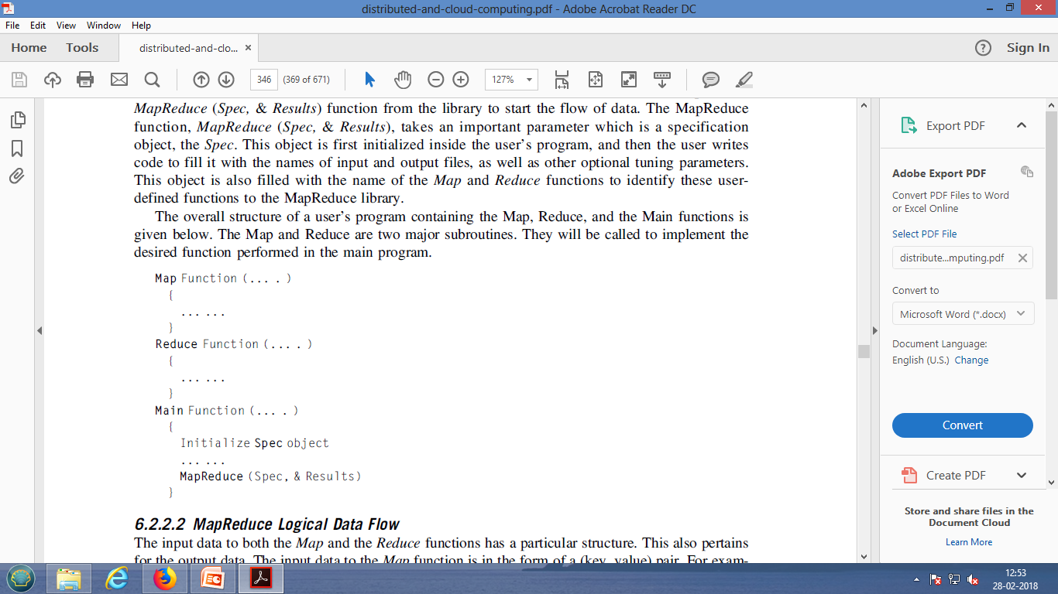
Map Reduce Function

Slide 11
What is MapReduce?
Simple data-parallel programming model
For large-scale data processing
Exploits large set of commodity computers
Executes process in distributed manner
Offers high availability
Pioneered by Google
Processes 20 petabytes of data per day
Popularized by open-source Hadoop project
Used at Yahoo!, Facebook, Amazon, …

Slide 12
What is MapReduce used for?
At Google:
Index construction for Google Search
Article clustering for Google News
Statistical machine translation
At Yahoo!:
“Web map” powering Yahoo! Search
Spam detection for Yahoo! Mail
At Facebook:
Data mining
Ad optimization
Spam detection

Slide 13
Motivation: Large Scale Data Processing
Many tasks composed of processing lots of data to produce lots of other data
Want to use hundreds or thousands of CPUs ... but this needs to be easy!
MapReduce provides
User-defined functions
Automatic parallelization and distribution
Fault-tolerance
I/O scheduling
Status and monitoring

Slide 14
What is MapReduce used for?
In research:
Astronomical image analysis (Washington)
Bioinformatics (Maryland)
Analyzing Wikipedia conflicts (PARC)
Natural language processing (CMU)
Particle physics (Nebraska)
Ocean climate simulation (Washington)

Slide 15
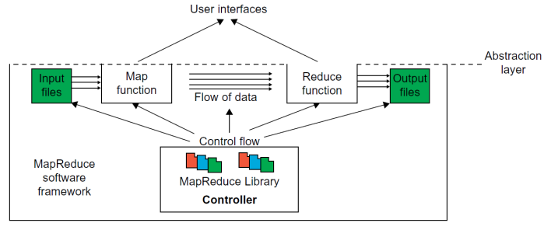
Map Reduce architecture

Slide 16
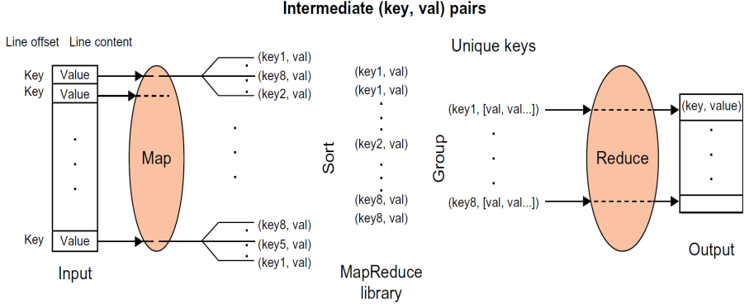
MapReduce Logical Data Flow

Slide 17
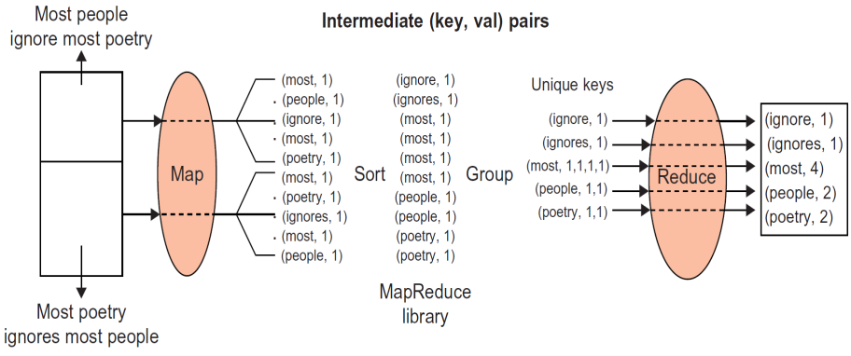
MapReduce Logical Data Flow

Slide 18
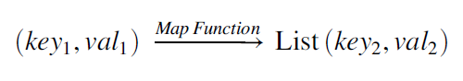
Formal Notation of MapReduce Data Flow
The Map function is applied in parallel to every input (key, value) pair,
produces new set of intermediate (key, value) pairs

Slide 19
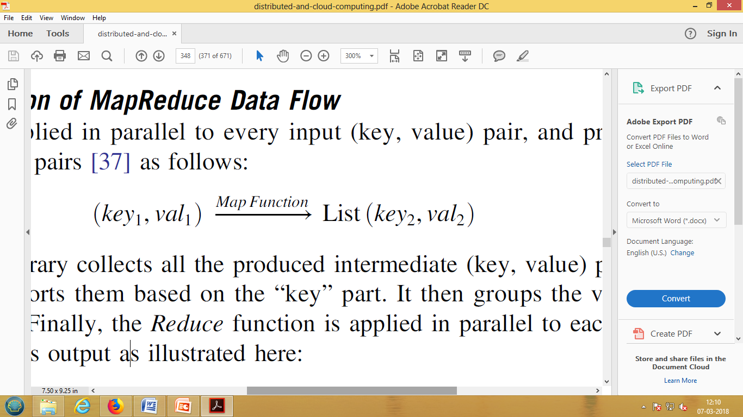
Formal Notation of MapReduce Data Flow
Then the MapReduce library collects all the produced intermediate (key, value) pairs from all input
(key, value) pairs, and sorts them based on the “key” part.
It then groups the values of all occurrences
of the same key.
Finally, the Reduce function is applied in parallel to each group producing the collection of values as output

Slide 20
Strategy to Solve MapReduce Problems
Problem 1: Counting the number of occurrences of each word in a collection of documents.
• Solution: unique “key”: each word, intermediate “value”: number of occurrences.
• Problem 2: Counting the number of occurrences of words having the same size, or the same number of letters, in a collection of documents.
• Solution: unique “key”: each word, intermediate “value”: size of the word.
• Problem 3: Counting the number of occurrences of anagrams in a collection of documents. Anagrams are words with the same set of letters but in a different order (e.g., the words “listen” and “silent”).
• Solution: unique “key”: alphabetically sorted sequence of letters for each word (e.g., “eilnst”), intermediate “value”: number of occurrences.

Slide 21
Strategy to Solve MapReduce Problems
Consider you have a MapReduce system which sorts given text into words with equal number of letters (Map) and gives the count for each(Reduce). Draw the data flow diagram for the above MapReduce system with the following two input files
File 1: Hey there I am using WhatsApp
File 2: Get ready and jump to the sky

Slide 22
Map+Reduce
Map:
Accepts input key/value pair
Emits intermediate key/value pair
Reduce :
Accepts intermediate key/value* pair
Emits output key/value pair
R
E
D
U
C
E
Very
big
data
M
A
P
Partitioning
Function
Result

Slide 23
Architecture overview
Master node
user
Job tracker
Slave node 1
Slave node 2
Slave node N
Task tracker
Task tracker
Task tracker
Workers
Workers
Workers

Slide 24
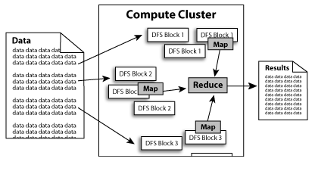
Processing overview

Slide 25
MapReduce Actual Data and Control Flow
Data partitioning
• Computation partitioning
• Determining the master and workers
• Reading the input data (data distribution)
• Map function
• Combiner function
• Partitioning function
• Synchronization
• Communication
• Sorting and Grouping
• Reduce function

Slide 26
DFD implementation MapReduce

Slide 27
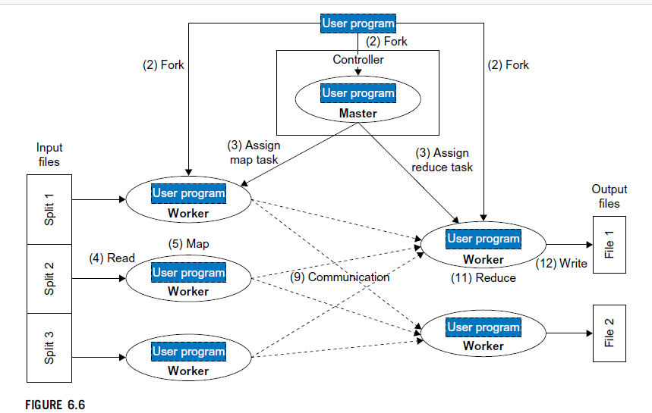
Control flow implementation MapReduce

Slide 28
Hadoop
software platform originally developed by Yahoo enabling users to write and run applications over vast distributed data.
Features of Hadoop :
> Scalable : can easily scale to store and process petabytes of data in the Web space
> Economical : An open-source MapReduce minimizes the overheads in task spawning and massive data communication.
> Efficient: Processing data with high-degree of parallelism across a large number of commodity nodes
> Reliable : Automatically maintains multiple copies of data to facilitate redeployment of computing tasks on failures

Slide 29
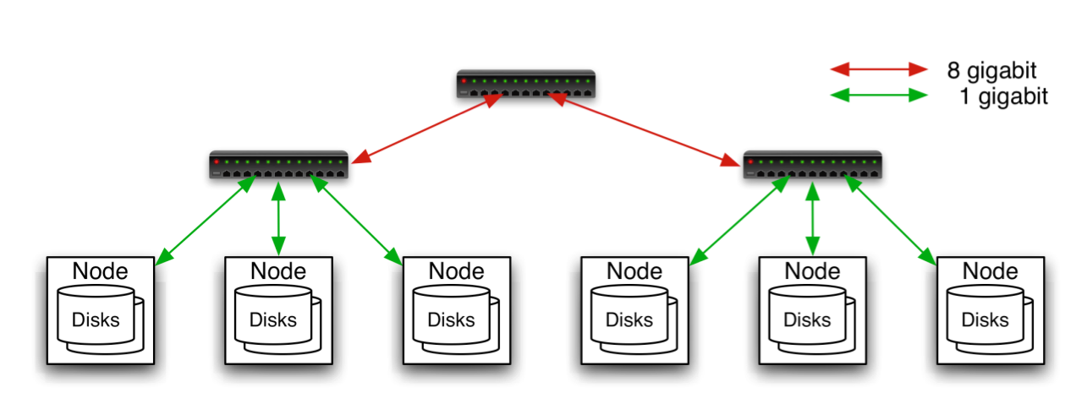
Typical Hadoop Cluster
Aggregation switch
Rack switch
40 nodes/rack, 1000-4000 nodes in cluster
1 Gbps bandwidth within rack, 8 Gbps out of rack
Node specs (Yahoo terasort): 8 x 2GHz cores, 8 GB RAM, 4 disks (= 4 TB?)

Slide 30
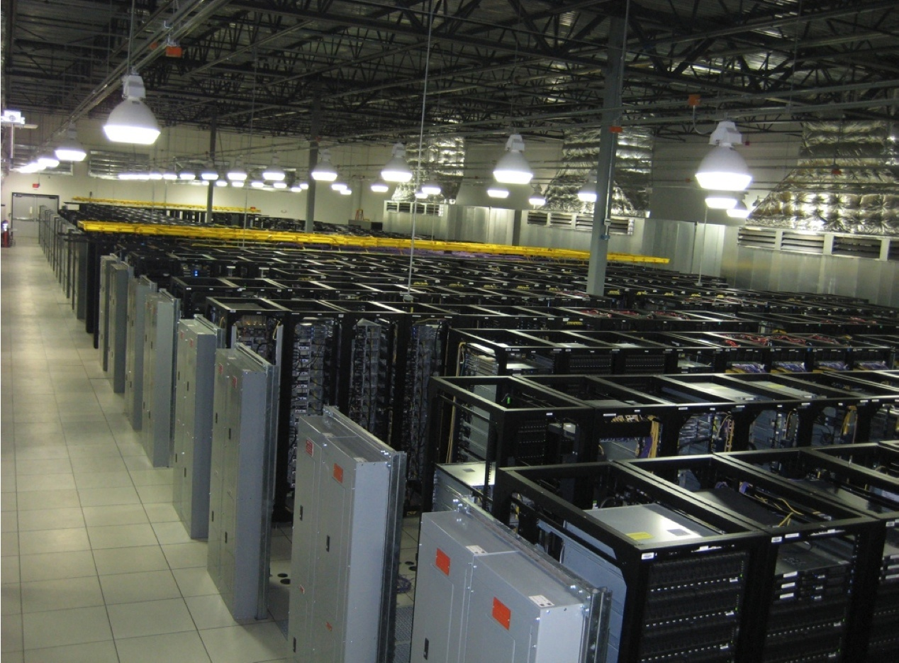
Typical Hadoop Cluster

Slide 31
Hadoop Components
Distributed file system (HDFS)
Single namespace for entire cluster
Replicates data 3x for fault-tolerance
MapReduce framework
Executes user jobs specified as “map” and “reduce” functions
Manages work distribution & fault-tolerance

Slide 32

Hadoop Distributed File System
Files split into 128MB blocks
Blocks replicated across several datanodes (usually 3)
Single namenode stores metadata (file names, block locations, etc)
Optimized for large files, sequential reads
Files are append-only
Namenode
1
2
1
3
2
1
4
2
4
3
3
4

Slide 33
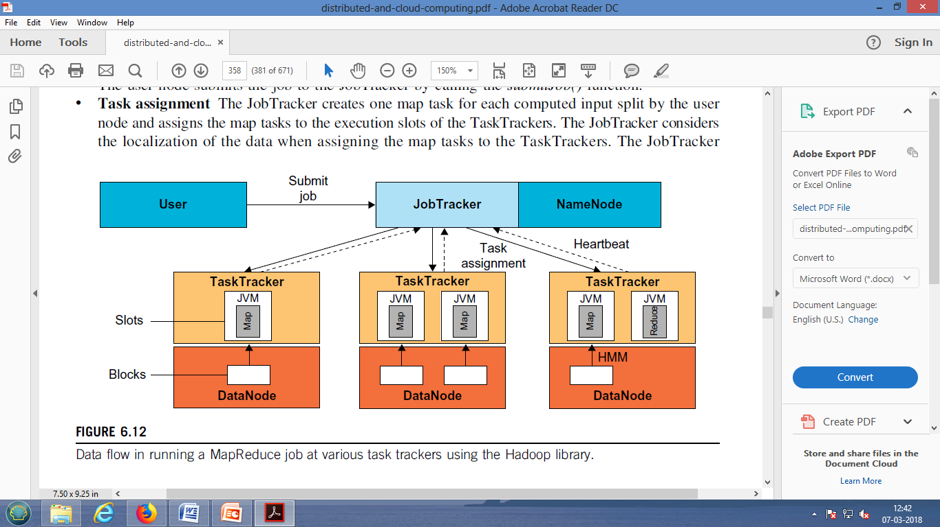
Architecture of MapReduce in Hadoop

Slide 34
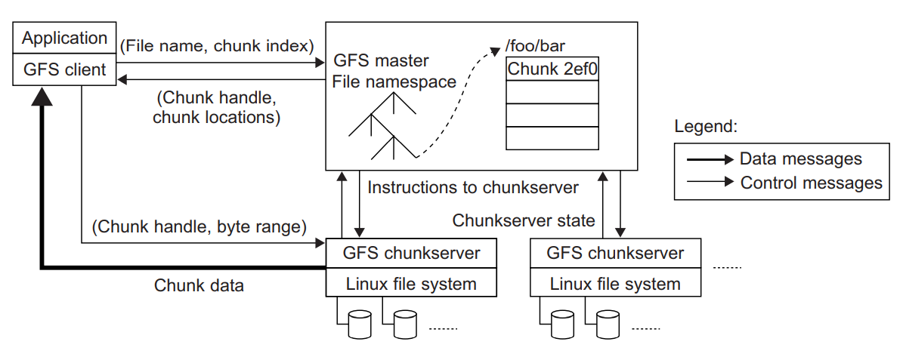
Google File System (GFS)

Slide 35
GFS: underlying storage system
Goal
global view
make huge files available in the face of node failures
Master Node (meta server)
Centralized, index all chunks on data servers
Chunk server (data server)
File is split into contiguous chunks, typically 16-64MB.
Each chunk replicated (usually 2x or 3x).
Try to keep replicas in different racks

Slide 36
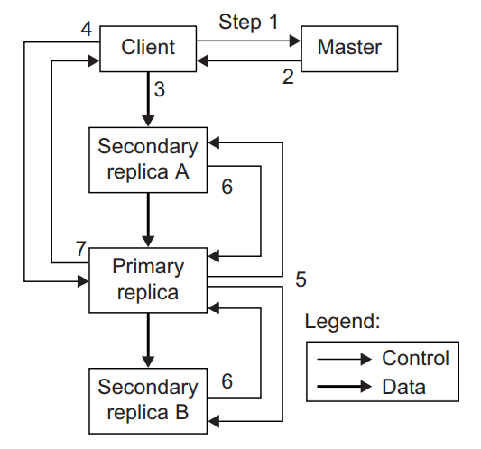
Data mutation sequence in GFS

Slide 37
Thank you

